Slide 1
Research Strategy Committee Introduction and Overview

Slide 2
Agenda
What is the RSC?
What are the benefits of submitting to the RSC?
What is the review process?
How do I submit?
Submission Guide

Slide 3
What is the RSC?
The Research Strategy Committee (RSC) is dedicated to reviewing new and ongoing human subjects research conducted through the department of Neurosurgery at Mount Sinai. RSC approval is required for all human subjects IRB submissions.
The committee's goals are to:
1. Review new research projects to ensure that they are both feasible and impactful.
2. Conduct yearly reviews of ongoing research to ensure that financial and scientific goals of the project are being met.
The RSC review process is a great opportunity to receive feedback on your research project.
The RSC Coordinator can help you flesh out your ideas into a protocol prepared for IRB review and help you with next steps towards RSC approval and beyond.

Slide 4
Where does the RSC fit into the process of starting up a research project as Mount Sinai?
RSC
Jurisdiction: research design and feasibility
RSC approval is the first step to starting a research project. A project cannot submit to the GCO/IRB without first going through the RSC.
GCO
Jurisdiction: grant submissions and contracts
IRB (PPHS)
Jurisdiction: human rights protections

Slide 5
Benefits of submitting to the RSC
---
---
---
Institutional guidance
Connection to funding opportunities
Fast feedback
Notes:
Guidance: fleshing out ideas, preparing to submit to other offices (PPHS, GCO)
Connection: funding opportunities, department and institutional resources
Fast feedback: feedback times around 1 business day vs 6-8 weeks (IRB)

Slide 6
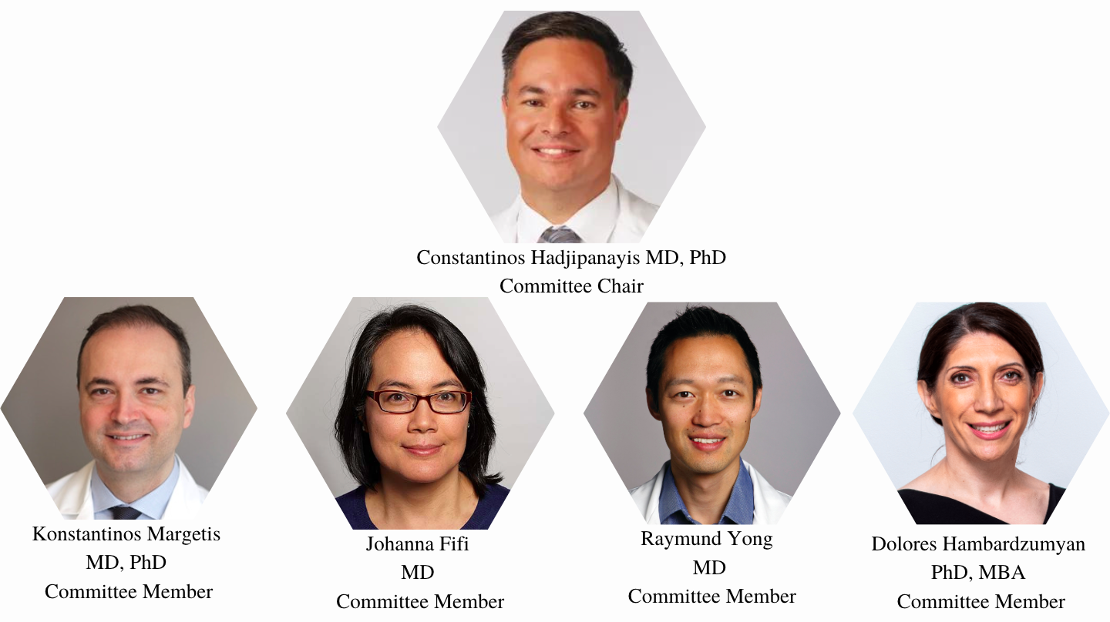
RSC Committee Members

Slide 7
What is the review process?
Submission
Initial Review
Committee Review

Slide 8
How do residents submit?
Submission
Initial Review
Committee Review
1. https://redcap.link/rscsubmission
2. Select one of the following form options:
- Faculty Retrospective Proposal
- Faculty Prospective Proposal
- Resident Retrospective Proposal
- Resident Prospective Proposal
-Yearly Review
3. Fill out the entire form with as much detail as requested

Slide 9
Initial Review
Submission
Initial Review
Committee Review
1. The RSC coordinator will review the submission
2. If needed, the submission will be sent back to the submitter for further edits.
Note: New studies almost always require additional edits. This is normal and does not mean your study will not be approved! These edits ensure that the submission is in the best possible shape for committee review and, eventually, IRB review.

Slide 10
Common Edits Requested
1. Incomplete form
2. Expected workload is unclear or too large for the size of the study team
3. Unexpected costs (REDCap, monitoring, data pulls ect).
4. Screening and consenting procedures are unclear

Slide 11
Committee Determinations:
Submission
Initial Review
Committee Review
Approve:
An approval form is issued to the submitter and the project is ready for IRB/GCO submission.
Conditionally Approve:
The project must be edited and then resubmitted for review by the committee. This project is not ready for IRB/GCO submission.
Deny:
The committee has denied the project. A decision letter detailing reasons for the committee’s decision is sent to the submitter. If these issues are corrected, the project can be resubmitted for committee review. *Note: the committee has never voted to deny a study

Slide 12
RSC Submission Guide

Slide 13
Submission Guide: Research Question and Endpoints
Primary and Secondary Endpoints
Research Question and Study Significance:
The research question should be well-defined.
Ex.) Terms like "good recovery" are very broad. What indicators will be used to determine a good recovery?
Study significance: Discuss the gap in knowledge that this study aims to address and how this study will address this gap. How will this benefit the field and/or those that this condition affects?
These are usually presented in bullets and are directly linked to the outcomes of statistical analysis
Ex.) Primary Endpoint:
The proportion of subjects with good clinical outcome defined as Modified Rankin Score (mRS) of ≤2 as assessed by a blinded assessor at 90 days (± 15 days)

Slide 14
Submission Guide: Stats and Enrollment
Statistical Plans
How do these meet primary and secondary endpoints? Are plans appropriate for the sample size/study goals?
Plan on who will conduct statistical analyses before data is collected. Be sure that this person is qualified to do so and assess any costs associated with outsourced analyses.
Conflicting studies that draw from the same patient pool should be considered when defining the enrollment goal
Enrollment Goal
Make sure this number is realistic and appropriate. Bigger estimations are not always better, especially if more complex statistical plans call for a larger sample size than is feasible ex.) rare diseases.
Is this goal feasible for the size of the study team? Will someone be able to cover recruitment and enrollment outside of business hours?

Slide 15
Submission Guide: Recruitment and Consent
Subject Population
Inclusion and exclusion criteria should be specific and clear.
Recruitment Plan
Walk reviewers through how potential participants will be identified and approached.
Keep in mind that the treating team must grant the study team permission to approach the patient for research purposes.
Consent Process
Include plans related to consent, assent, where documents will be stored and whether teleconsent will be sought.
For retrospective studies (most commonly): will a waiver of consent be sought?

Slide 16
Submission Guide: Study Team and COI
Risks
Database Considerations
Loss of data/confidentiality is almost always a risk. Include this in your submission. ​
Be sure to not only include risks, but specify how these risks will be mitigate or managed ​
Ex.) "De-identified data will be stored on a HIPAA compliant database and will only be accessible by the research team" ​
If PHI will be stored for research purposes, it must be stored in a HIPAA compliant database. ​
All databases must be assessed and approved by IT security. If the database has not been authorized, it must be submitted for approval. This process may take a few weeks.

Slide 17
Submission Guide: Study Team and COI
Study Team and Required Effort
Conflicts of Interest
The workload must be manageable for the size of the study team.
Please note that the department only provides CRC assistance for funded studies
How long will data entry take per patient? Who will enter data, conduct follow-up procedures, be responsible for consent and randomization procedures? Are there multiple sites where these procedures will occur?
This applies to PI's and Sub-I's. If your faculty mentor has a conflict of interest, a management plan may be suggested by FCOI

