Slide 1
RSC REDCap Submission Forms
Research Strategy Committee
May 4, 2022

Slide 2
Features and Procedure
Features
1. One link for all forms
2. Real-time statistics for all submitted projects
3. Committee review procedures do not change, no REDCap login required to submit or review proposals
Procedure
REDCap Submission
-Submitted via REDCap link. Login is not necessary.
-Submitter can edit the form per queries submitted by the coordinator
Initial Review
-Coordinator reviews submission, includes comments in the REDCap form, and sends back to the submitter for edits (if need be)
Committee Review
-Members receive the protocol and a PDF of the REDCap form to conduct their review
-Votes are emailed as before
Notes:
All in all, procedures on the committee end stay the same and the form to be reviewed is concise and uniform.

Slide 3
Submission Form at a Glance
Link: https://redcap.link/rscsubmission
Basic submission information
The form will auto populate depending on the form selected here.
Link to a quiz that tells the submitter which form should be submitted for review.

Slide 4
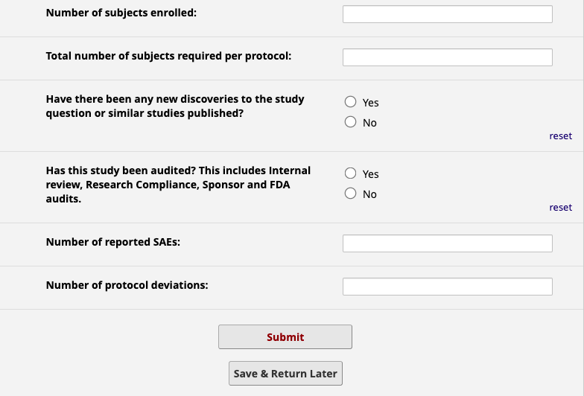
Submitter Capabilities
Submitters have the option to:
-Save and return later using an automated link unique to their submission
-Receive a confirmation email with a PDF of the form submitted
-Edit responses after submission

Slide 5
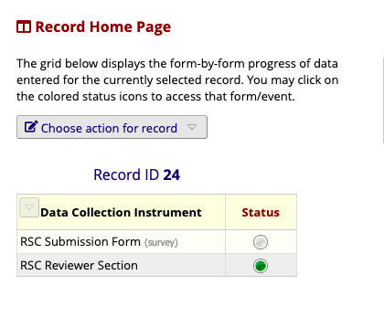
RSC Coordinator Dashboard:
RSC Submission Form:
-Able to edit between the submitter and reviewer, no redcap login necessary.
RSC Reviewer Section:
-Project demographics (response times, sub-field etc.) used to generate reports.
-Only reviewer can view/edit

Slide 6
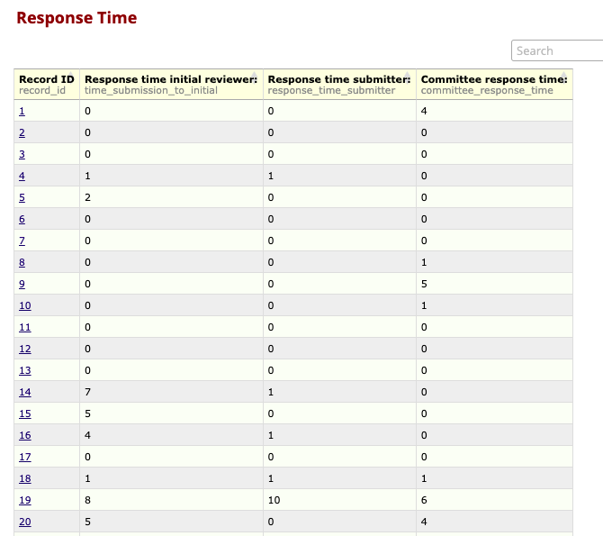
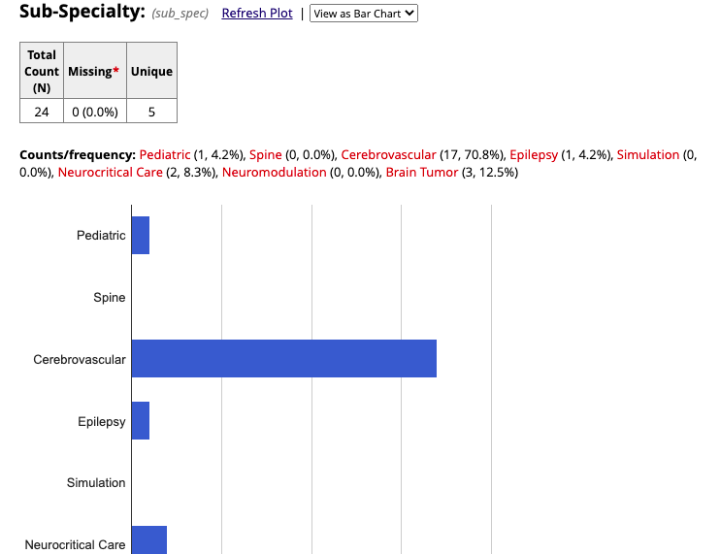
Custom Reports

Slide 7
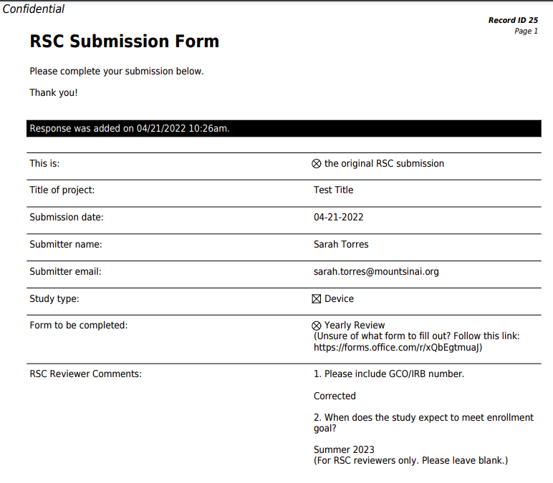
Committee members will not need to log in to REDCap to review submissions.
Committee members will be sent the protocol and a PDF of the REDCap submission to conduct their review.
Decisions can be submitted via email as before.
Notes:
No more formatting issues

Slide 8
Thank you! Any Questions?

